Slide 1
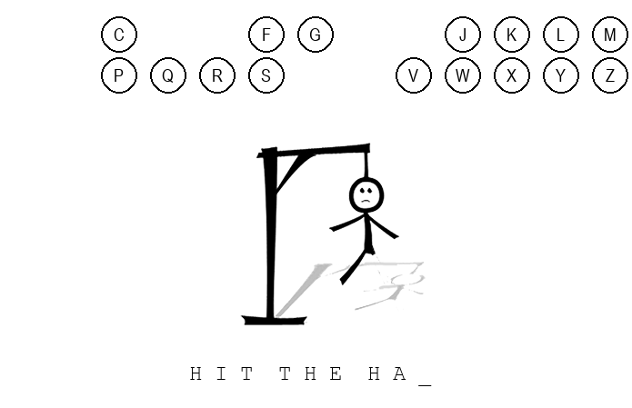
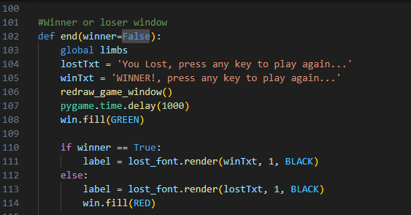
Hangman-2025
Sharpen Your Mind, One Letter at a Time.
Project member: Briohny Phengsy
Hangman-2025 is the modern adaptation of the classic childhood game Hangman. The goal is simple: guess the letters that form the hidden word. Each correct guess uncovers a new piece of the puzzle, bringing you closer to solving it. However beware, only five wrong guesses stand between you and the hangman’s fate.
https://github.com/ksu-is/Hangman-2025

